Slide 1



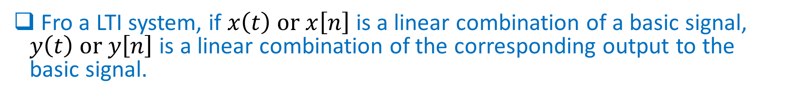

Fourier, Laplace, and Z Transform
Definition
Objective: analyze a LTI system (signal decomposition)
$x(t)$ or
$$x[n]$$
LTI
$$y\left(t\right) or y[n]$$
Fro a LTI system, if $x\left(t\right) or x\left[n\right]$ is a linear combination of a basic signal, $y\left(t\right) or y\left[n\right]$ is a linear combination of the corresponding output to the basic signal.
A basic signal should satisfy
It can be used to construct a broad and useful class of signals
The response of an LTI system to the basic signal is simple

Slide 2
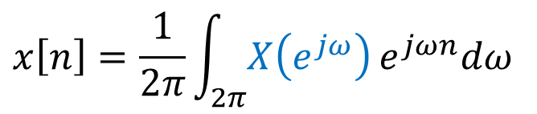
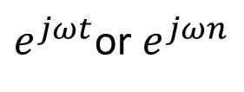
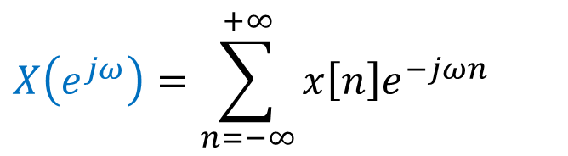
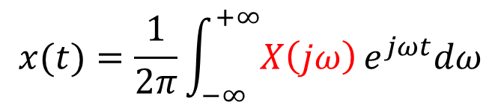
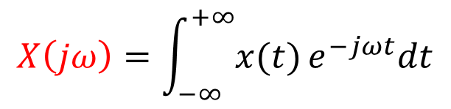
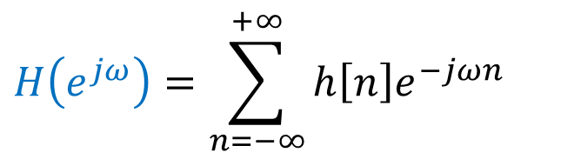
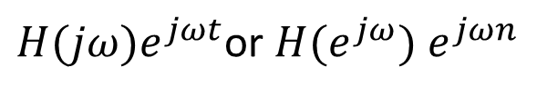
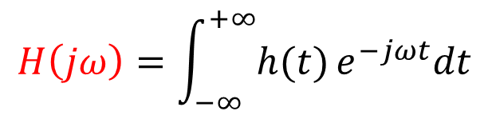
Fourier, Laplace, and Z Transform
Definition
Fourier transform
LTI
$H(jω)e^{jωt}$or $H(e^{jω}) e^{jωn}$
$e^{jωt}$or $e^{jωn}$
$$x(t)=\frac{1}{2π}\int_{−∞}^{+∞}{X\left(jω\right)}e^{jωt}dω$$
$$H\left(jω\right)=\int_{−∞}^{+∞}{h(t)}e^{−jωt}dt$$
$$X\left(jω\right)=\int_{−∞}^{+∞}{x(t)}e^{−jωt}dt$$
$$x\left[n\right]=\frac{1}{2π}\int_{2π}^{ }{X\left(e^{jω}\right)}e^{jωn}dω$$
$$H\left(e^{jω}\right)=\sum_{n=−∞}^{+∞}{h\left[n\right]e^{−jωn}}$$
$$X\left(e^{jω}\right)=\sum_{n=−∞}^{+∞}{x\left[n\right]e^{−jωn}}$$
Fourier transform has convergence problem $⟹$ Laplace or Z transform

Slide 3

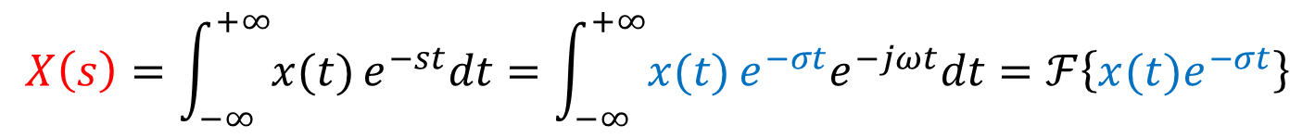
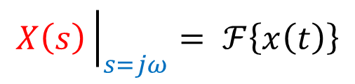

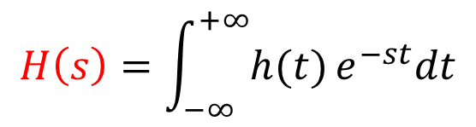
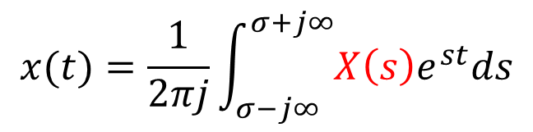

Fourier, Laplace, and Z Transform
Definition
Laplace transform
$$e^{st}$$
LTI
$$H(s)e^{st}$$
$$x(t)=\frac{1}{2πj}\int_{σ−j∞}^{σ+j∞}{X\left(s\right)e^{st}ds}$$
$$H\left(s\right)=\int_{−∞}^{+∞}{h(t)}e^{−st}dt$$
$$X\left(s\right)=\int_{−∞}^{+∞}{x(t)}e^{−st}dt=\int_{−∞}^{+∞}{x(t)}e^{−σt}e^{−jωt}dt=ℱ\left\{x(t)e^{−σt}\right\}$$
$$X\left(s\right){\left.​\right|}_{s=jω}= ℱ\left\{x\left(t\right)\right\}$$
ROC determined by $σ$

Slide 4
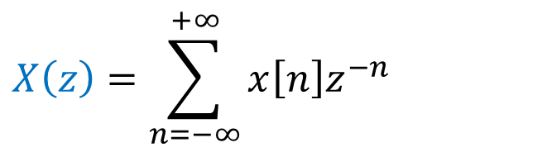
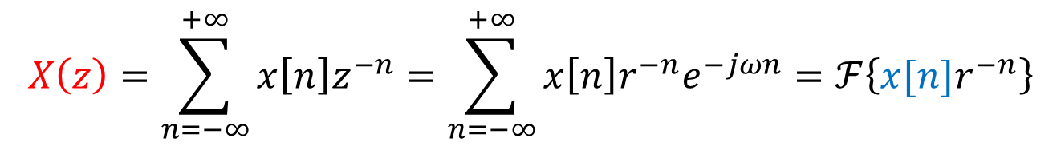


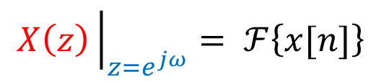


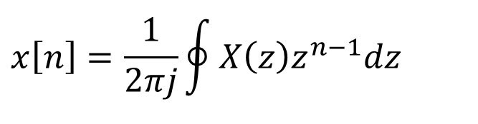
Fourier, Laplace, and Z Transform
Definition
Z transform
$$z^{n}$$
LTI
$$H(z)z^{n}$$
$$x\left[n\right]=\frac{1}{2πj}\oint{X\left(z\right)z^{n−1}dz }$$
$$H\left(z\right)=\sum_{n=−∞}^{+∞}{h\left[n\right]z^{−n}}$$
$$X\left(z\right)=\sum_{n=−∞}^{+∞}{x\left[n\right]z^{−n}}$$
$$X\left(z\right)=\sum_{n=−∞}^{+∞}{x\left[n\right]z^{−n}}=\sum_{n=−∞}^{+∞}{x\left[n\right]r^{−n}e^{−jωn}}=ℱ\left\{x[n]r^{−n}\right\}$$
ROC determined by $r$
$$X\left(z\right){\left.​\right|}_{z=e^{jω}}= ℱ\left\{x[n]\right\}$$

Slide 5


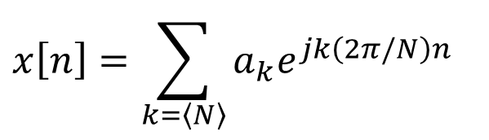

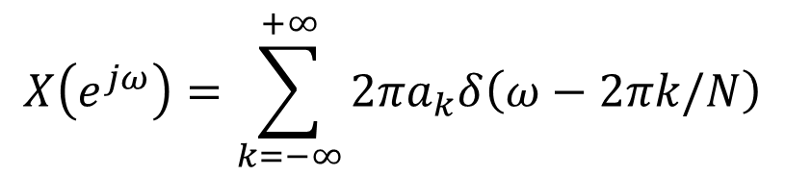
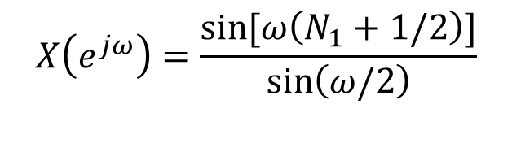

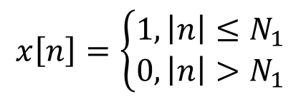
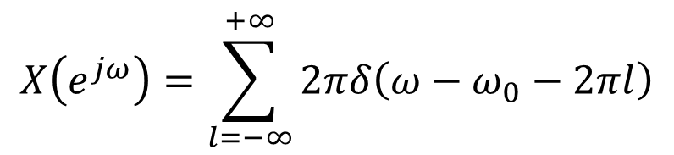
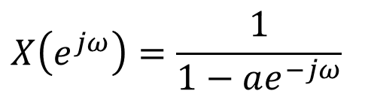
Fourier, Laplace, and Z Transform
Definition
Fourier transform of periodic signal
$$x[n]=e^{jω_{0}n}$$
$$X\left(e^{jω}\right)=\sum_{l=−∞}^{+∞}{2πδ\left(ω−ω_{0}−2πl\right)}$$
Some Fourier transform pairs
$$x\left[n\right]=\sum_{k=\left\langle N\right\rangle }{a_{k}e^{jk\left(2π/N\right)n}}$$
$$X\left(e^{jω}\right)=\frac{1}{1−ae^{−jω}}$$
$$x\left[n\right]=a^{n}u\left[n\right], \left|a\right|<1$$
$$X\left(e^{jω}\right)=\sum_{k=−∞}^{+∞}{2πa_{k}δ\left(ω−2πk/N\right)}$$
$$x\left[n\right]=\left\{\begin{aligned}1,\left|n\right|≤N_{1} \\ 0, \left|n\right|>N_{1}\end{aligned}\right.$$
$$X\left(e^{jω}\right)=\frac{\sin{[ω\left(N_{1}+1/2\right)]}}{\sin\left(ω/2\right)}$$
$$x\left[n\right]=δ[n]$$
$$X\left(e^{jω}\right)=1$$

Slide 6
Definition
Some Laplace transform pairs

Slide 7
Definition
Some Z transform pairs

Slide 8
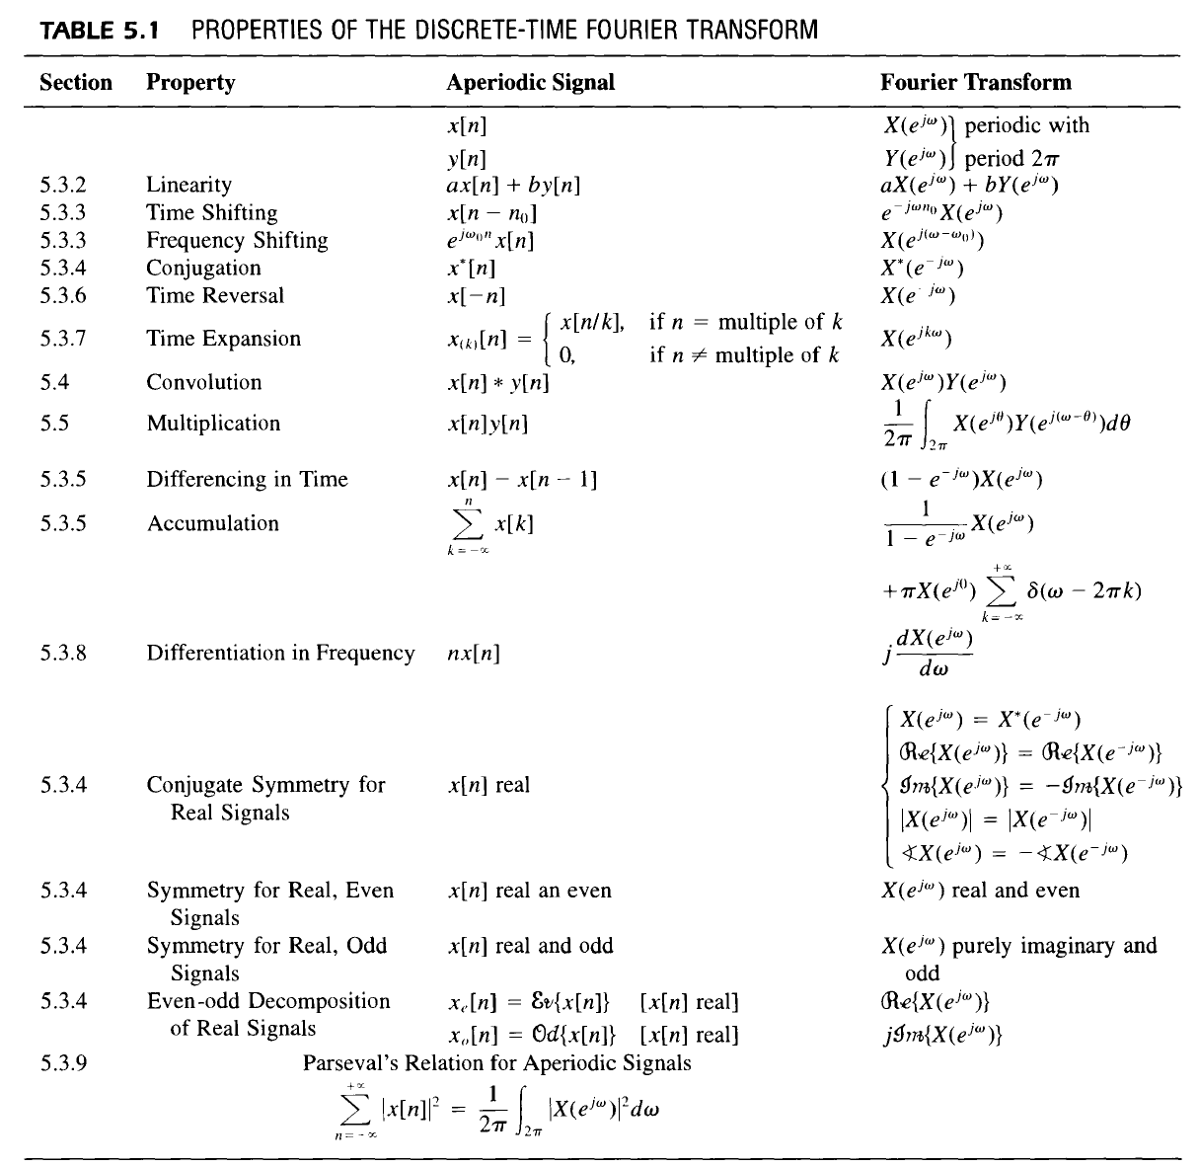
Fourier, Laplace, and Z Transform
Properties
DT Fourier
transform

Slide 9
Fourier, Laplace, and Z Transform
Properties
Laplace
transform

Slide 10
Fourier, Laplace, and Z Transform
Properties
Z transform

Slide 11
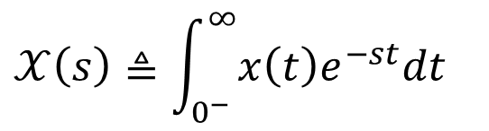
Fourier, Laplace, and Z Transform
Properties
Unilateral Laplace transform
Note: no ROC is specified cause it is always the right-half plane
$$𝒳\left(s\right)≜\int_{0^{−}}^{∞}{x\left(t\right)e^{−st}dt}$$

Slide 12
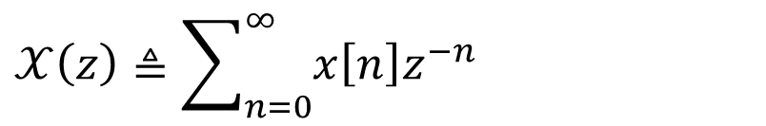
Fourier, Laplace, and Z Transform
Properties
Unilateral Z transform
$$𝒳\left(z\right)≜\sum_{n=0}^{∞}{x\left[n\right]z^{−n}}$$

Slide 13
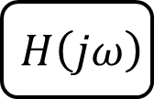




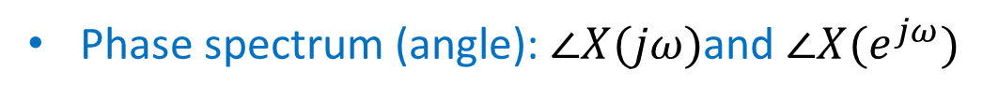


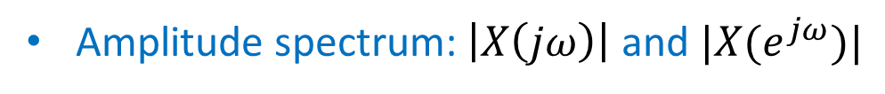


Fourier, Laplace, and Z Transform
Applications
Fourier transform
Signal
$$X(jω)=|X(jω)|e^{j∠X(jω)}$$
$$X(e^{jω})=|X(e^{jω})|e^{j∠X(e^{jω})}$$
Amplitude spectrum:$\left|X\left(jω\right)\right|$ and $|X(e^{jω})|$
Phase spectrum (angle): $∠X(jω)$and $∠X(e^{jω})$
System: frequency response $H(jω)=|H(jω)|e^{j∠H(jω)}$ or $H(e^{jω})=|H(e^{jω})|e^{j∠H(e^{jω})}$
$$H\left(jω\right)$$
$$X(jω)$$
$$Y\left(jω\right)=H\left(jω\right)X(jω)$$
$$Y\left(jω\right)=H\left(jω\right)X\left(jω\right)=|H(jω)||X(jω)|e^{j\left(∠H\left(jω\right)+∠X(jω)\right)}$$
Example
$$x\left(t\right)=5sin\left(ω_{0}t+π/2\right)$$
$$y\left(t\right)=?$$
$$x\left(t\right)=5$$
$$y\left(t\right)=?$$

Slide 14
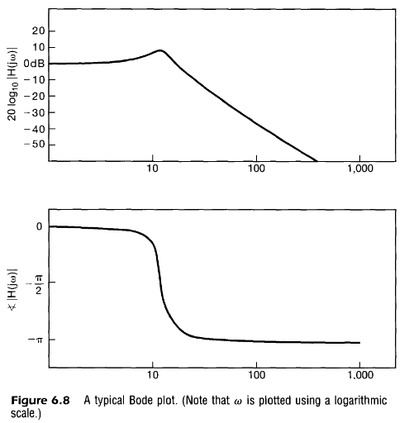
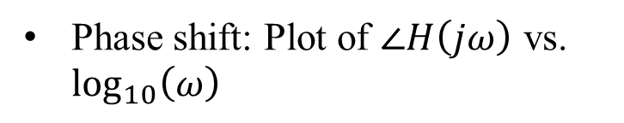
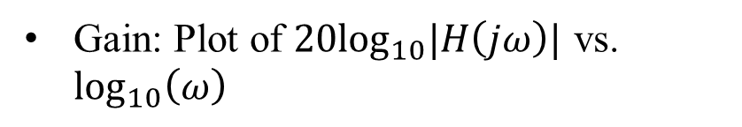
Fourier, Laplace, and Z Transform
Applications
Fourier transform
Bold plots of frequency response
Gain: Plot of $20\log_{10}|H\left(jω\right)|$ vs. $\log_{10}\left(ω\right)$
Phase shift: Plot of $∠H\left(jω\right)$ vs. $\log_{10}\left(ω\right)$

Slide 15








Fourier, Laplace, and Z Transform
Applications
Laplace transform
Characterization of a LTI system: Causality and stability
Causal
$$⟹$$
ROC of $H\left(s\right)$ is a right-half plane
ROC of $H\left(s\right)$ is the right-half plane to the right of the right-most pole
A rational $H\left(s\right)$is causal
$$⟺$$
Stable
$$⟺$$
The ROC of $H\left(s\right)$ includes the entire $jω$-axis
Causal and Stable
$$⟺$$
All the poles of $H\left(s\right)$ lie in the left-half of the $s$-plane (All the poles have negative real parts)

Slide 16
Fourier, Laplace, and Z Transform
Applications
Laplace transform
Geometry evaluation the Fourier transform
$$X\left(s\right)=\frac{1}{s+1/2}, ℛℯ\left\{s\right\}>−\frac{1}{2}$$
$${\left|X\left(jω\right)\right|}^{2}=\frac{1}{ω^{2}+{\left(1/2\right)}^{2}}$$
$$∢X\left(jω\right)=−\tan^{−1}{2ω}$$

Slide 17
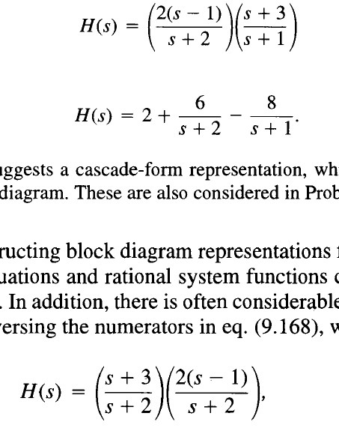
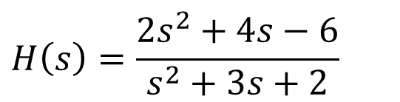
Fourier, Laplace, and Z Transform
Applications
Laplace transform
Block diagram representation
Direct form
$$H\left(s\right)=\frac{2s^{2}+4s−6}{s^{2}+3s+2}$$
Parallel form
Cascade form

Slide 18


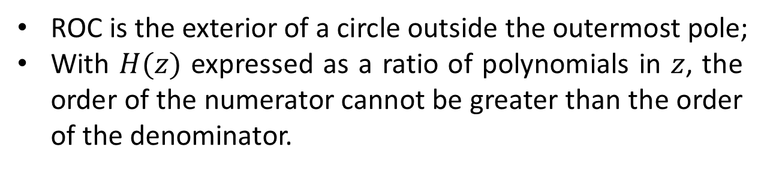
Fourier, Laplace, and Z Transform
Applications
Z transform
Characterization of a LTI system: Causality and stability
Causal
$$⟹$$
ROC of $H\left(z\right)$ is the exterior of a circle, including infinity
A rational $H\left(z\right)$is causal
$$⟺$$
ROC is the exterior of a circle outside the outermost pole;
With $H(z)$ expressed as a ratio of polynomials in $z$, the order of the numerator cannot be greater than the order of the denominator.
Stable
$$⟺$$
The ROC of $H\left(z\right)$ includes the unit circle, $\left|z\right|=1$
Causal and Stable
$$⟺$$
All of the poles of $H\left(z\right)$ lie inside the unit circle. (magnitude smaller than 1)

Slide 19
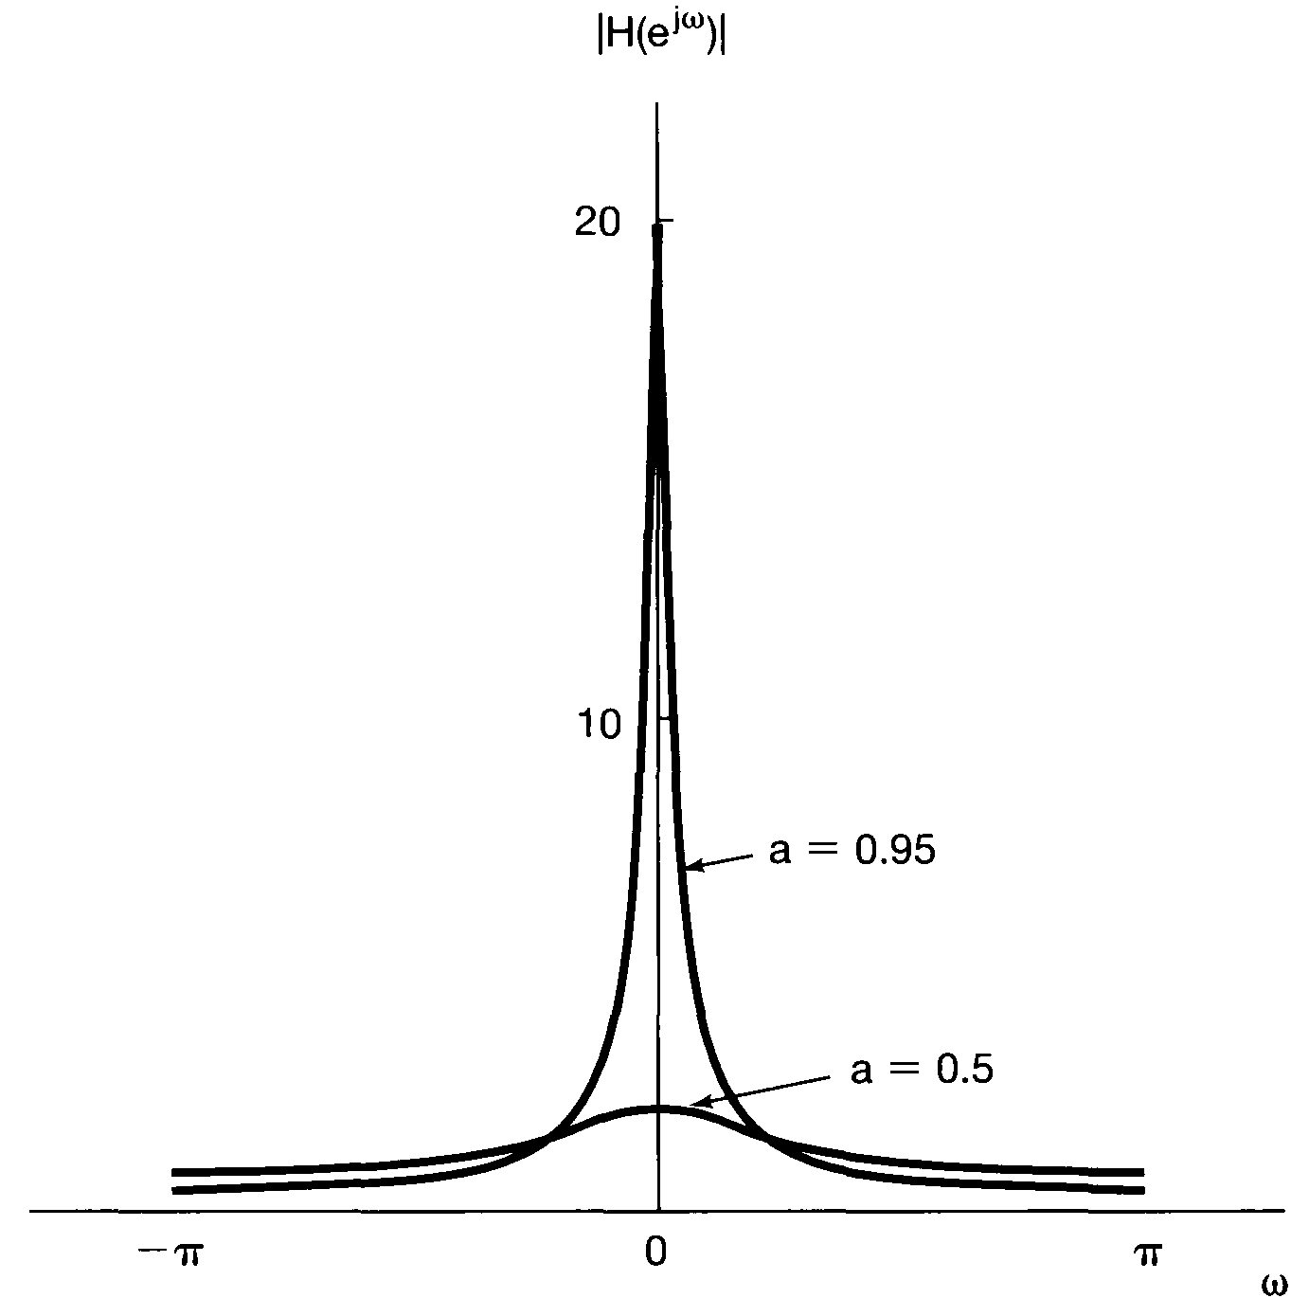
Fourier, Laplace, and Z Transform
Applications
Z transform
Geometry evaluation the Fourier transform
$$H\left(z\right)=\frac{1}{1−az^{−1}}=\frac{z}{z−a}, \left|z\right|>\left|a\right|$$
$$H\left(e^{jω}\right)=\frac{1}{1−ae^{−jω}}$$

Slide 20
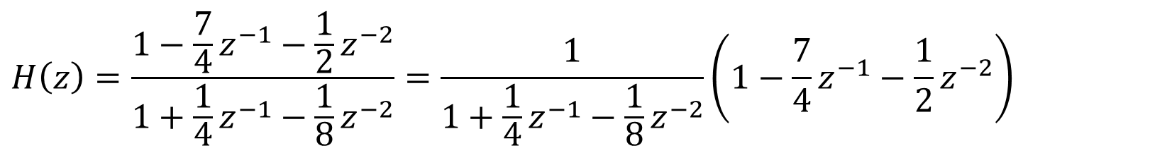
Fourier, Laplace, and Z Transform
Applications
Z transform
Block diagram representation
$$H\left(z\right)=\frac{1−\frac{7}{4}z^{−1}−\frac{1}{2}z^{−2}}{1+\frac{1}{4}z^{−1}−\frac{1}{8}z^{−2}}=\frac{1}{1+\frac{1}{4}z^{−1}−\frac{1}{8}z^{−2}}\left(1−\frac{7}{4}z^{−1}−\frac{1}{2}z^{−2}\right)$$

Slide 21
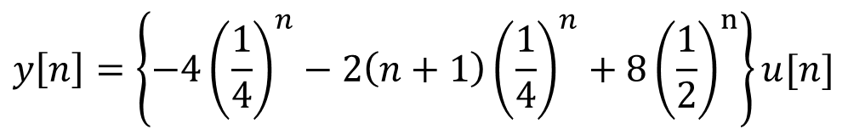
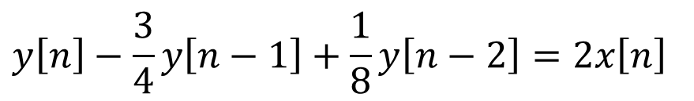
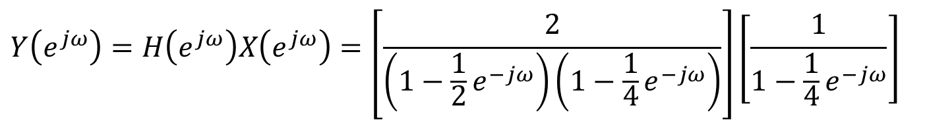
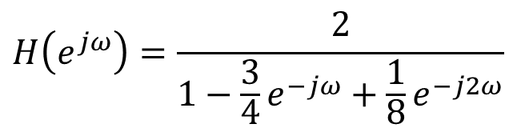

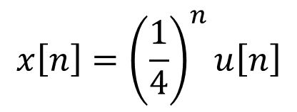
Fourier, Laplace, and Z Transform
Applications
Difference or differential equations
$$y\left[n\right]−\frac{3}{4}y\left[n−1\right]+\frac{1}{8}y\left[n−2\right]=2x\left[n\right]$$
$$x\left[n\right]={\left(\frac{1}{4}\right)}^{n}u\left[n\right]$$
$$y\left[n\right]=?$$
Fourier transform
$$H\left(e^{jω}\right)=\frac{2}{1−\frac{3}{4}e^{−jω}+\frac{1}{8}e^{−j2ω}}$$
$$Y\left(e^{jω}\right)=H\left(e^{jω}\right)X\left(e^{jω}\right)=\left[\frac{2}{\left(1−\frac{1}{2}e^{−jω}\right)\left(1−\frac{1}{4}e^{−jω}\right)}\right]\left[\frac{1}{1−\frac{1}{4}e^{−jω}}\right]$$
$$y\left[n\right]=\left\{−4{\left(\frac{1}{4}\right)}^{n}−2\left(n+1\right){\left(\frac{1}{4}\right)}^{n}+8{\left(\frac{1}{2}\right)}^{n}\right\}u[n]$$

Slide 22

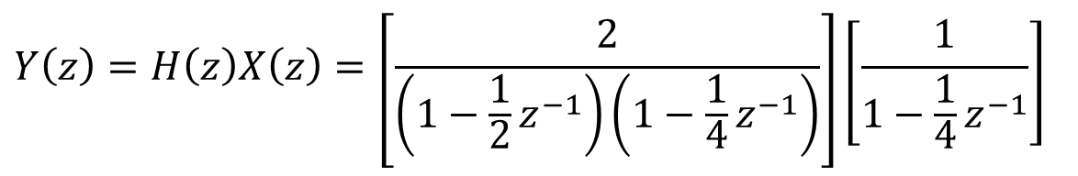
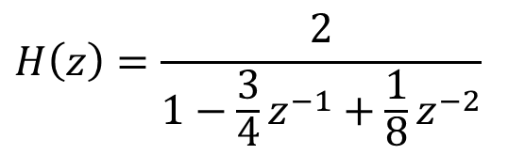
Fourier, Laplace, and Z Transform
Applications
Difference or differential equations with initial rest condition
$$y\left[n\right]−\frac{3}{4}y\left[n−1\right]+\frac{1}{8}y\left[n−2\right]=2x\left[n\right]$$
$$x\left[n\right]={\left(\frac{1}{4}\right)}^{n}u\left[n\right]$$
$$y\left[n\right]=?$$
Z transform
$$H\left(z\right)=\frac{2}{1−\frac{3}{4}z^{−1}+\frac{1}{8}z^{−2}}$$
$$Y\left(z\right)=H\left(z\right)X\left(z\right)=\left[\frac{2}{\left(1−\frac{1}{2}z^{−1}\right)\left(1−\frac{1}{4}z^{−1}\right)}\right]\left[\frac{1}{1−\frac{1}{4}z^{−1}}\right]$$
$$y\left[n\right]=⋯$$
Depends on the ROC of Y(z)

Slide 23
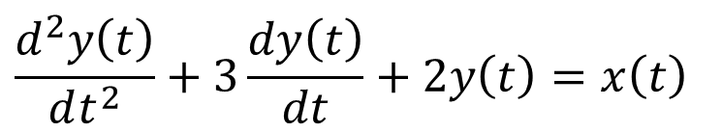

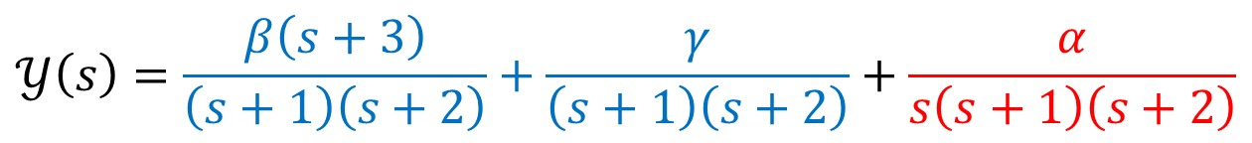
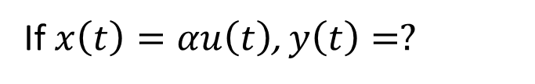

Fourier, Laplace, and Z Transform
Applications
Difference or differential equations with initial values
$$\frac{d^{2}y\left(t\right)}{dt^{2}}+3\frac{dy\left(t\right)}{dt}+2y\left(t\right)=x\left(t\right)$$
$$y\left(0^{−}\right)=β$$
$$y′\left(0^{−}\right)=γ$$
If $x\left(t\right)=αu\left(t\right)$, $y\left(t\right)=?$
$$s^{2}𝒴\left(s\right)−βs−γ+3s𝒴\left(s\right)−3β+2𝒴\left(s\right)=\frac{α}{s}$$
$$𝒴\left(s\right)=\frac{β\left(s+3\right)}{\left(s+1\right)\left(s+2\right)}+\frac{γ}{\left(s+1\right)\left(s+2\right)}+\frac{α}{s\left(s+1\right)\left(s+2\right)}$$
Zero-input response
Zero-state response

Slide 24
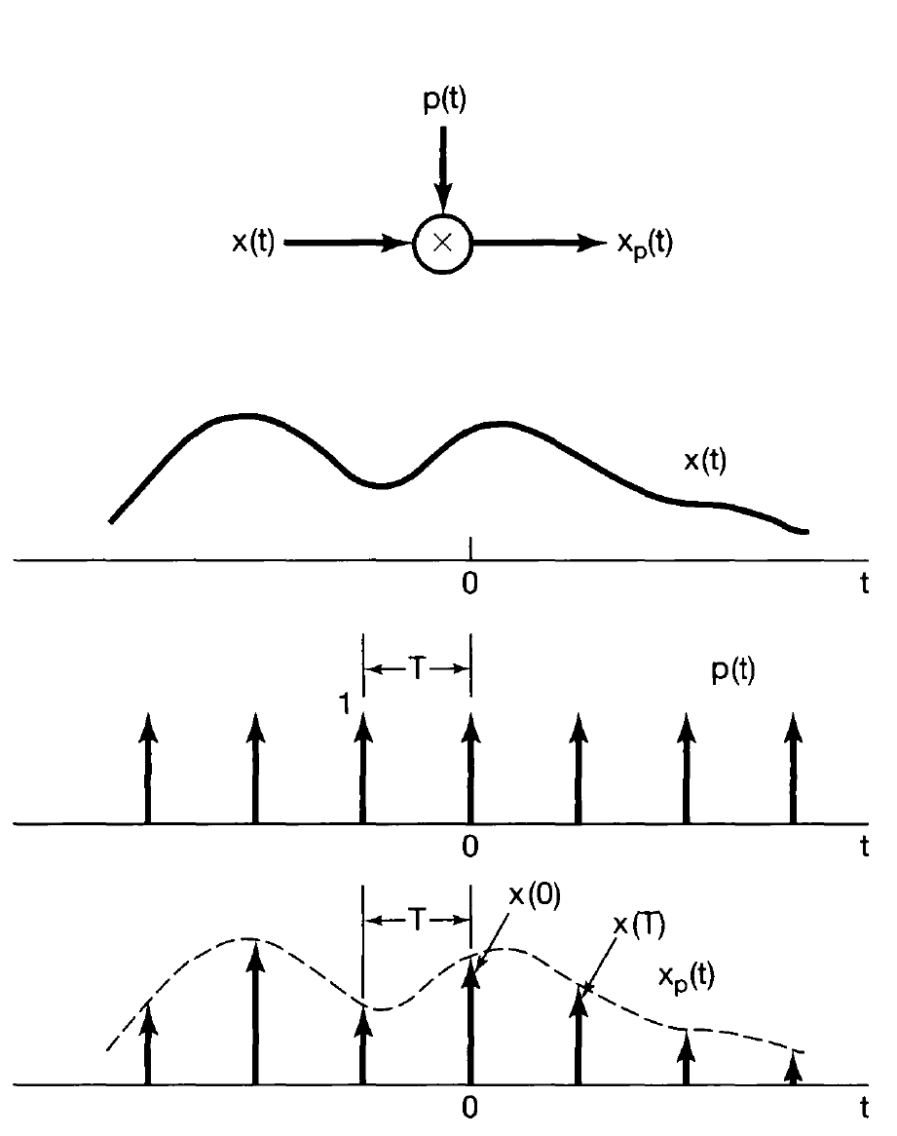

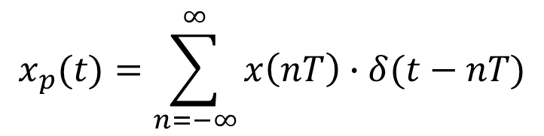

Sampling
Impulse-Train Sampling
$$x_{p}(t)=x\left(t\right)∙p(t)$$
$$p(t)=\sum_{n=−∞}^{∞}{δ(t−nT)}$$
$$x_{p}(t)=\sum_{n=−∞}^{∞}{x\left(nT\right)∙δ(t−nT)}$$

Slide 25










Sampling
Impulse-Train Sampling
$$P\left(jω\right)=\frac{2π}{T}\sum_{K=−∞}^{∞}{δ\left(ω−kω_{s}\right)}$$
$$=\frac{2π}{T}\sum_{K=−∞}^{∞}{δ\left(ω−k\frac{2π}{T}\right)}$$
$$X_{p}(jω)=\frac{1}{2π}X\left(jω\right)∗P(jω)$$
$$ω_{M}<ω_{s}−ω_{M}$$
$$=\frac{1}{2π}\int_{−∞}^{∞}{X\left(jθ\right)P\left(j(ω−θ)\right)dθ}$$
$$=\frac{1}{T}\sum_{K=−∞}^{∞}{X\left(j\left(ω−k∙ω_{s}\right)\right)}$$
$$ω_{M}>ω_{s}−ω_{M}$$

Slide 26

Sampling
Impulse-Train Sampling

Slide 27


Sampling
Recovery of the CT signal
Ideal low-pass filtering
$$H\left(jω\right)$$

Slide 28






Sampling
Recovery of the CT signal
$$=\left[\sum_{n=−∞}^{∞}{x\left(nT\right)∙δ(t−nT)}\right]∗h(t)$$
$$x_{r}(t)=x_{p}(t)∗h(t)$$
Ideal low-pass filtering
$$x_{p}(t)$$
$$=\sum_{n=−∞}^{∞}{x\left(nT\right)h(t−nT) }$$
$$h(t)=\frac{{Tω}_{c}}{π}\frac{\sin{ω_{c}t}}{ω_{c}t}$$

Slide 29






Sampling
Recovery of the CT signal
$$=\sum_{n=−∞}^{∞}{x\left(nT\right)h(t−nT) }$$
$$x_{r}(t)=x_{p}(t)∗h(t)$$
Zero-order hold
$$H_{0}\left(jω\right)=e^{−jωT/2}\left[\frac{2\sin{ωT}}{ω}\right]$$
$$X_{p}\left(jω\right)$$
$$X_{0}\left(jω\right)$$

Slide 30



Sampling
Recovery of the CT signal
$$=\sum_{n=−∞}^{∞}{x\left(nT\right)h(t−nT) }$$
$$x_{r}(t)=x_{p}(t)∗h(t)$$
First-order hold
$$H\left(jω\right)=\frac{1}{T}{\left[\frac{\sin{(ωT/2)}}{ω/2}\right]}^{2}$$
Linear interpolation

Slide 31





Sampling
C/D conversion
$$x_{p}(t)=\sum_{n=−∞}^{∞}{x\left(nT\right)∙δ(t−nT)}$$
$$x_{c}(t)$$
$$x_{d}[n]=x_{c}(nT)$$
$X_{d}\left(e^{jΩ}\right)=X_{p}\left(jΩ/T\right)$

Slide 32




Sampling
Overall system
$$⟺$$
$$ω= Ω/T$$
$$H_{c}\left(jω\right)=\left\{\begin{matrix}H_{d}\left(e^{jωT}\right), \left|ω\right|<ω_{s}/2 \\ 0, \left|ω\right|>ω_{s}/2\end{matrix}\right.$$

Slide 33





Sampling
Sampling of DT signals
$$x_{p}\left[n\right]=x\left[n\right]p\left[n\right]$$
N: sampling period
$$X_{p}\left(e^{jω}\right)=\frac{1}{N}\sum_{K=0}^{N−1}{X\left(e^{j\left(ω−k∙ω_{s}\right)}\right)}$$
$$ω_{M}<ω_{s}−ω_{M}$$
$$ω_{M}>ω_{s}−ω_{M}$$

Slide 34





Sampling
Decimation (sample rate decrease, SRD)
$$x_{b}\left[n\right]=x_{p}[nN]$$
$$x_{b}\left[n\right]=x[nN]$$
$$X_{b}\left(e^{jω}\right)=X_{p}\left(e^{jω/N}\right)$$

Slide 35


Sampling
Decimation (sample rate decrease, SRD)
Prevent aliasing by LPF in front of SRD $⟹$ Decimator

Slide 36

Sampling
Interpolation (SRI)
Prevent mirrors by LPF after SRI $⟹$ Interpolator
Upsampling by a factor of 2

Slide 37
Good Luck!

